Slide 1
Balking Systems
Rushil Chugh
Nikhil Khatu
CSC 777

Slide 2
Terminology used
Traffic intensity (A)
Inter arrival time (λ)
Service time (μ)
Impatience time (α)
Balking probability (p)

Slide 3
Correlation to what has been covered
Full availability system – Customer finds the server idle and is serviced without going into the queue (a<1)
Limited Availability – Customer finds the server busy and waits in the queue (a>1)
The latter scenario is where the concept of Balking is so evident in the real world scenario

Slide 4
Balking Systems - Introduction
What are Balking Systems?
Example – Customer care scenario
Difference between balking and reneging

Slide 5
Why study Balking Systems?
Why do customers balk?
Impatience from customers
Does impatience affect performance?
It contributes to an increase in response time, thus depreciating performance
So, why study balking systems?
Use in Telecommunication systems, Call Centers

Slide 6

Flow of a typical Balking System
λ
μ
Balking?
No
Queue
λ
μ
Yes
Yes
Retry?
Impatient?
Yes
Notes:
6

Slide 7
Scenarios
No Balking, no impatience
Balking, no impatience
No Balking, Impatience
There can be more scenarios as well where a combination of the above can happen

Slide 8
Simulation of Scenarios
λ
μ
Balking?
No
Queue
λ
μ
Yes
Yes
Retry?
Impatient?
Yes

Slide 9
Metrics affecting performance
Inter arrival time
Service time
Reneging times
Balking probability
Retrial inter arrival times

Slide 10
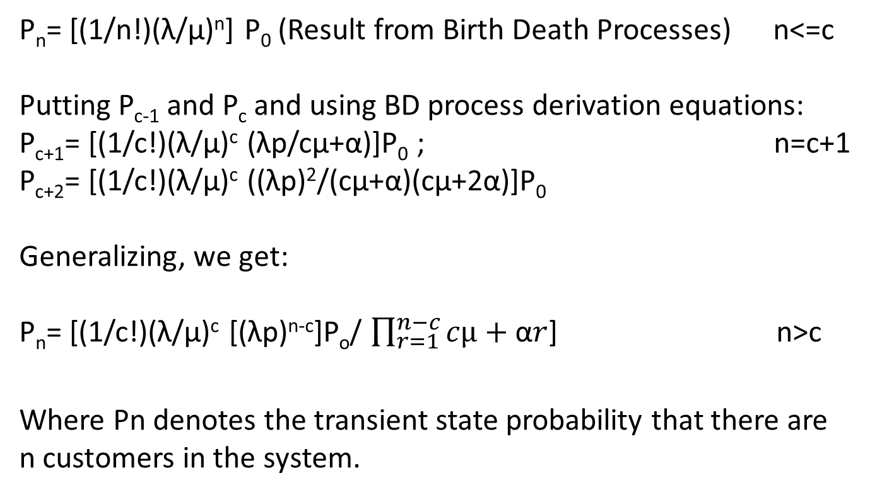
Balking in M/M/s
P_{n}= [(1/n!)(λ/μ)^{n}] P₀ (Result from Birth Death Processes) n<=c
Putting P_{c-1} and P_{c} and using BD process derivation equations:
P_{c+1}= [(1/c!)(λ/μ)^{c} (λp/cμ+α)]P₀ ; n=c+1
P_{c+2}= [(1/c!)(λ/μ)^{c} ((λp)²/(cμ+α)(cμ+2α)]P₀
Generalizing, we get:
P_{n}= [(1/c!)(λ/μ)^{c} [(λp)^{n-c}]P_{o}/ $\prod_{r=1}^{n−c}{cµ+\text{α}r}$] n>c
Where Pn denotes the transient state probability that there are n customers in the system.
Notes:
By applying the normalizing condition, we get:
P_{o} = [$\sum_{j=0}^{c}{\text{(1/}\text{j}\text{!)(}\text{λ}\text{/}\text{μ}\text{)}\text{j}\text{+(1/}\text{c}\text{!)}\text{(}\text{λ}\text{/}\text{μ}\text{)}\text{c}}\sum_{j=1}^{∞}{[\left(\text{λ}\text{2}\text{/}\text{c}\text{μ}\text{)}\text{j}\text{ /}\prod_{r=1}^{j}{cµ+\text{α}r}\right] ]}$

Slide 11
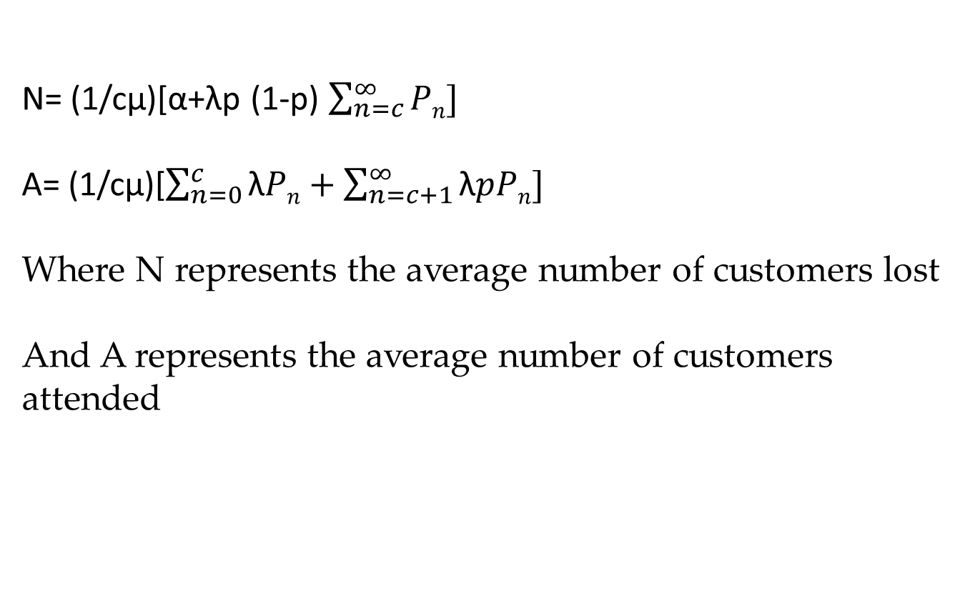
Other results
N= (1/cμ)[α+λp (1-p) $\sum_{n=c}^{∞}{Pn]}$
A= (1/cμ)[$\sum_{n=0}^{c}{\text{λ}Pn+\sum_{n=c+1}^{∞}{\text{λ}pPn]}}$
Where N represents the average number of customers lost
And A represents the average number of customers attended

Slide 12
Considerations for Algorithm
Followed the algorithm for a regular M/M/s queue
Response time was calculated by taking inter arrival time, service time, impatient time and retrial times for all individual calls into consideration.
Buffer had a finite value
All the aforementioned times are mutually independent.
Customer reneges if the waiting time is above a particular threshold value
Retrial inter arrival times assumed to be exponential

Slide 13
Considerations for Simulation
Service rate was kept fixed at 1 customer per 1 ms.
Number of buffers were fixed at 10
Number of servers and arrival rate was varied to obtain respective response times.
The customer balks with a probability of 0.2

Slide 14
Results of Simulation for number of servers=3
Response time vs Lambda | No. of servers = 3
Response Time (ms) | Lambda (Customers per ms)
0.275615 | 0.2
0.517 | 0.3
1.30433 | 0.4
1.51234 | 0.5
1.75072 | 0.6
2.16763 | 0.7
2.37624 | 0.8
2.45622 | 0.9
2.54721 | 1
2.64682 | 1.2
2.75313 | 1.4
2.83562 | 1.6
2.94453 | 1.8
3.008 | 2

Slide 15
Results of Simulation for number of servers=4
Response time vs Lambda | No. of servers = 4
Response Time (ms) | Lambda (Customers per ms)
0.24307 | 0.2
0.46532 | 0.3
1.03064 | 0.4
1.50169 | 0.5
1.55284 | 0.6
2.07193 | 0.7
2.18843 | 0.8
2.33869 | 0.9
2.40513 | 1
2.52783 | 1.2
2.64623 | 1.4
2.75441 | 1.6
2.84671 | 1.8
2.89864 | 2

Slide 16
Results of Simulation for number of servers=10
Response time vs Lambda | No. of servers = 10
Response Time (ms) | Lambda (Customers per ms)
0.093043 | 0.2
0.365216 | 0.3
0.930796 | 0.4
1.351521 | 0.5
1.617698 | 0.6
1.864737 | 0.7
2.0790085 | 0.8
2.2217555 | 0.9
2.2848735 | 1
2.4014385 | 1.2
2.5139185 | 1.4
2.6166895 | 1.6
2.7043745 | 1.8
2.753708 | 2

Slide 17
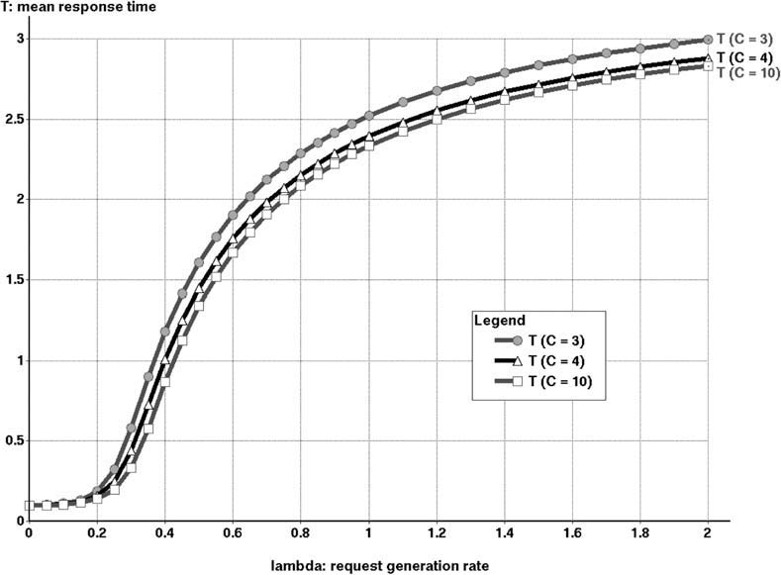
Expected results for Simulation

Slide 18
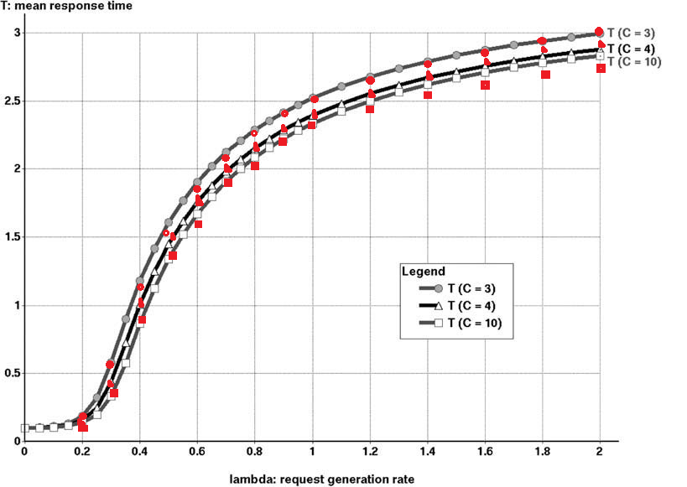
Expected vs Calculated results for Simulation

Slide 19
References
Finite-source M/M/S retrial queue with search for balking and impatient customers from the orbit Patrick Wüchner , , János Sztrik , Hermann de Meer
On a multiserver markovian queueing system with balking and reneging
A. Montazer-Haghighi, J. Medhi, S.G. Mohanty
On the impact of customer balking, impatience and retrials in telecommunication systems
J.R. Artalejo , V. Pla
ECE 777 – Dr. Dutta’s class lectures

Slide 20
Test your comprehension
Can a customer both balk and renege? How?
Which out of balking and reneging is worse for performance and why?
Does balking mitigate loss?

